Slide 1
EEE 414
Electrical Services Design
A Project on Electrical Design on Seven-Storeyed Building
Project By
1706040- Habibullah Khan
1706041- Deb. Indronil Sajib
1706042- Md Monirul Islam
1706044- Shuvro chowdhury
1706051- Sariha Noor azad
1706055- Adib Md Ridwan

Slide 2
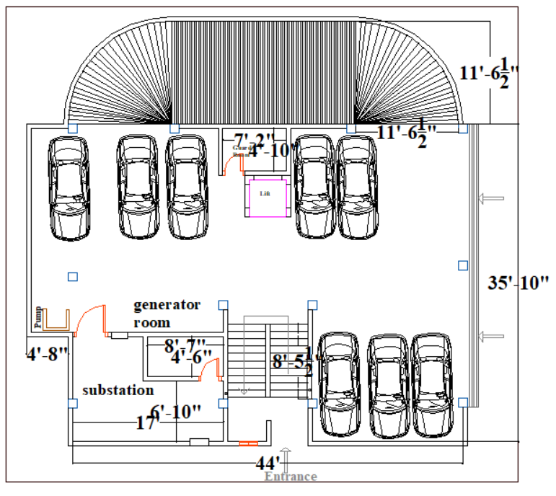
Floor Plan – Ground Floor

Slide 3
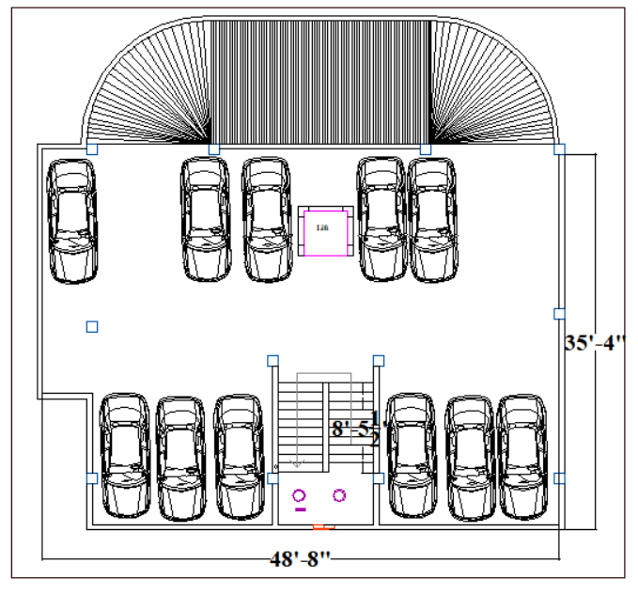
Floor Plan – 1st & 2nd Floor

Slide 4
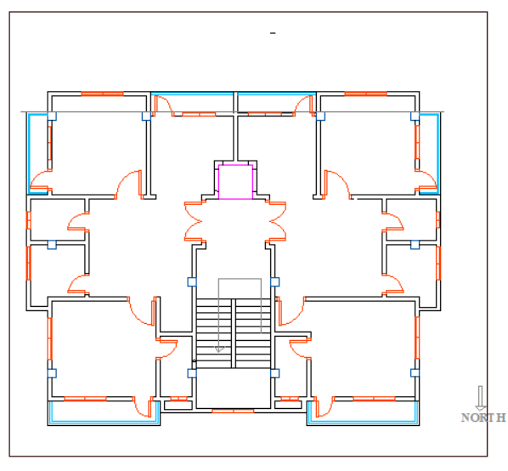
Floor Plan –third and above Floor

Slide 5
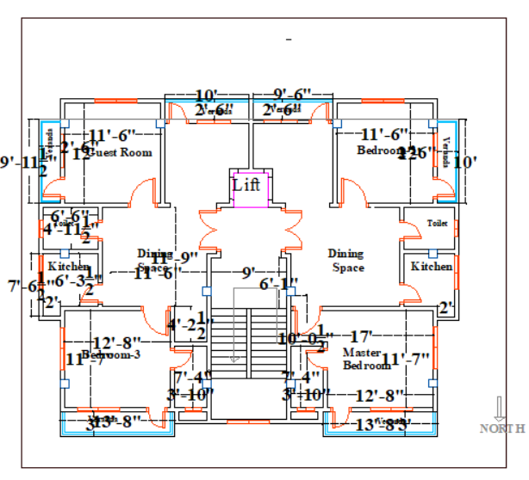
Floor Plan –third and above Floor

Slide 6

Ground Floor (Substation)
Sample Calculation for Light Bulbs and Fans
Lights:
Illuminance ,E = 150 lux
Area , A = (6.6 * 16.01) sq-ft = 105.666 sq-ft = 105.666/10.76 m² = 9.82 m²
Lumen of the light bulbs (10 Watt LED bulb), F = 1250 lm
Light loss factor* Utilization factor = LLF * UF = 0.75
Number of lights per illuminare, n=1
Number of light bulbs required = N
So, E = $\frac{n×N×F×LLF×UF}{A}$ => N = $\frac{E×A}{n×F×LLF×UF}$ = $\frac{150×9.82}{1×1250×0.75}$ = 1.5712 ≈ 2

Slide 7
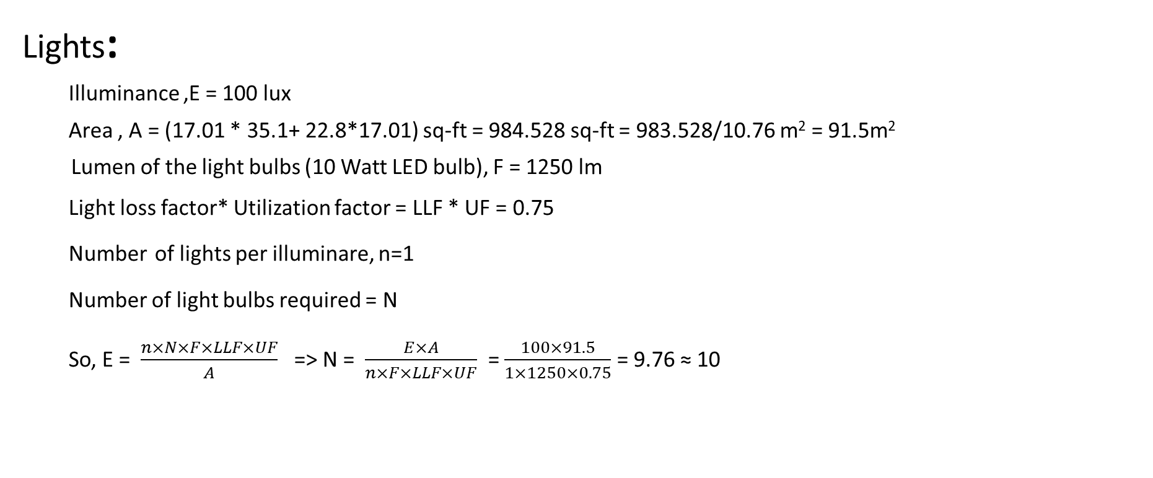
Ground Floor (Garage)
Sample Calculation for Light Bulbs and Fans
Lights:
Illuminance ,E = 100 lux
Area , A = (17.01 * 35.1+ 22.8*17.01) sq-ft = 984.528 sq-ft = 983.528/10.76 m² = 91.5m²
Lumen of the light bulbs (10 Watt LED bulb), F = 1250 lm
Light loss factor* Utilization factor = LLF * UF = 0.75
Number of lights per illuminare, n=1
Number of light bulbs required = N
So, E = $\frac{n×N×F×LLF×UF}{A}$ => N = $\frac{E×A}{n×F×LLF×UF}$ = $\frac{100×91.5}{1×1250×0.75}$ = 9.76 ≈ 10

Slide 8
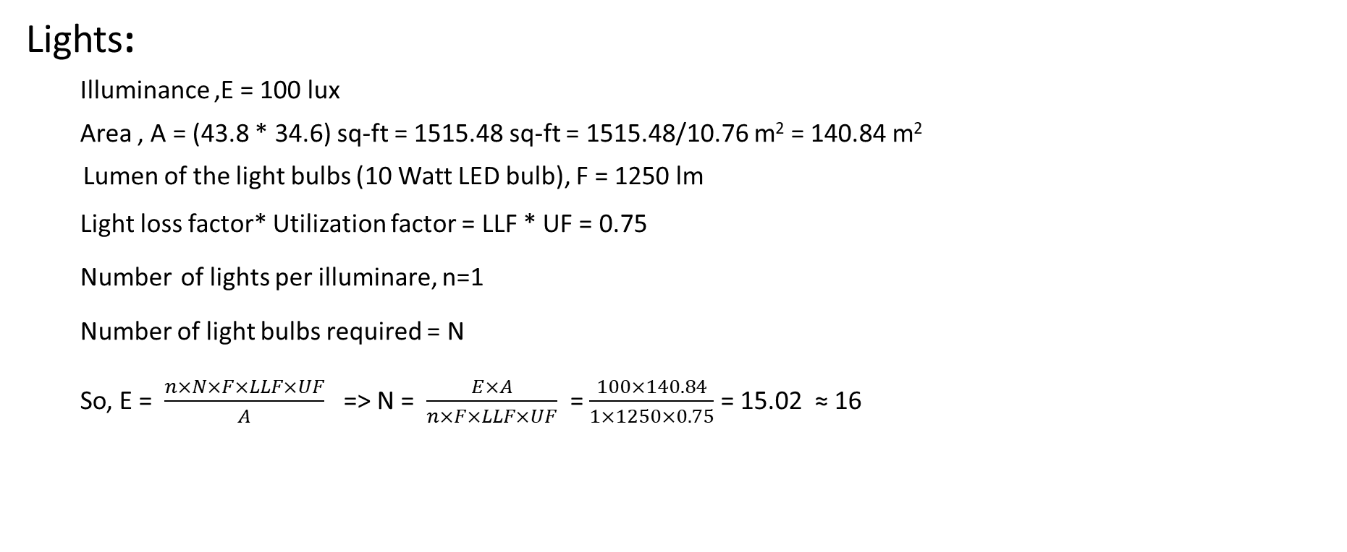
First Floor (Garage)
Sample Calculation for Light Bulbs and Fans
Lights:
Illuminance ,E = 100 lux
Area , A = (43.8 * 34.6) sq-ft = 1515.48 sq-ft = 1515.48/10.76 m² = 140.84 m²
Lumen of the light bulbs (10 Watt LED bulb), F = 1250 lm
Light loss factor* Utilization factor = LLF * UF = 0.75
Number of lights per illuminare, n=1
Number of light bulbs required = N
So, E = $\frac{n×N×F×LLF×UF}{A}$ => N = $\frac{E×A}{n×F×LLF×UF}$ = $\frac{100×140.84}{1×1250×0.75}$ = 15.02 ≈ 16

Slide 9
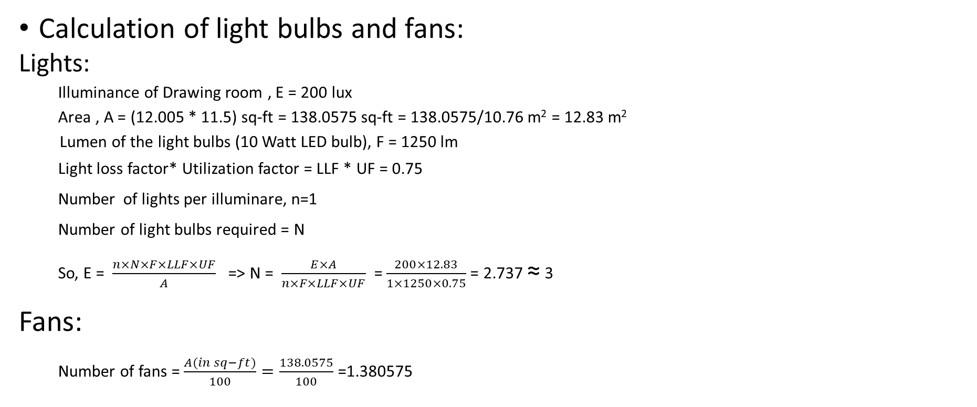
3rd floor (Guestroom)
Sample Calculation for Light Bulbs and Fans
Calculation of light bulbs and fans:
Lights:
Illuminance of Drawing room , E = 200 lux
Area , A = (12.005 * 11.5) sq-ft = 138.0575 sq-ft = 138.0575/10.76 m² = 12.83 m²
Lumen of the light bulbs (10 Watt LED bulb), F = 1250 lm
Light loss factor* Utilization factor = LLF * UF = 0.75
Number of lights per illuminare, n=1
Number of light bulbs required = N
So, E = $\frac{n×N×F×LLF×UF}{A}$ => N = $\frac{E×A}{n×F×LLF×UF}$ = $\frac{200×12.83}{1×1250×0.75}$ = 2.737 ≈ 3
Fans:
Number of fans = $\frac{A(in sq−ft)}{100}=\frac{138.0575}{100}$ =1.380575

Slide 10
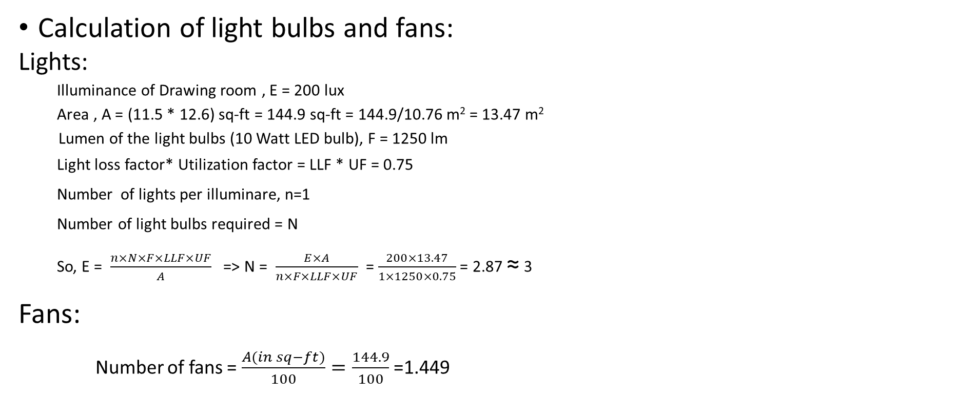
3rd floor (bedroom)
Sample Calculation for Light Bulbs and Fans
Calculation of light bulbs and fans:
Lights:
Illuminance of Drawing room , E = 200 lux
Area , A = (11.5 * 12.6) sq-ft = 144.9 sq-ft = 144.9/10.76 m² = 13.47 m²
Lumen of the light bulbs (10 Watt LED bulb), F = 1250 lm
Light loss factor* Utilization factor = LLF * UF = 0.75
Number of lights per illuminare, n=1
Number of light bulbs required = N
So, E = $\frac{n×N×F×LLF×UF}{A}$ => N = $\frac{E×A}{n×F×LLF×UF}$ = $\frac{200×13.47}{1×1250×0.75}$ = 2.87 ≈ 3
Fans:
Number of fans = $\frac{A(in sq−ft)}{100}=\frac{144.9}{100}$ =1.449

Slide 11
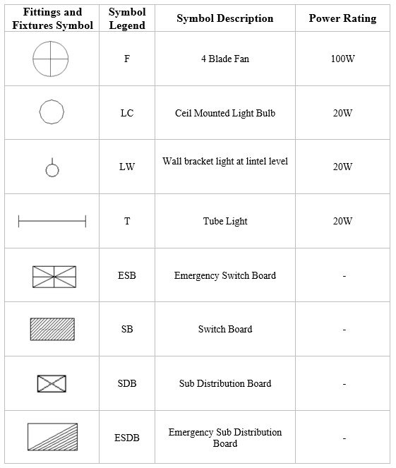
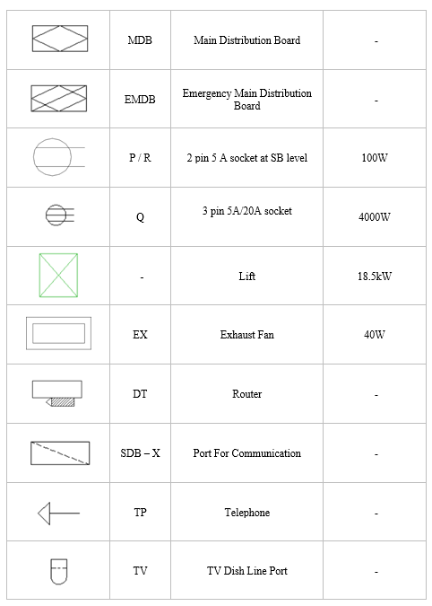
Electrical Appliances and Fixture / Fittings Schedule

Slide 12
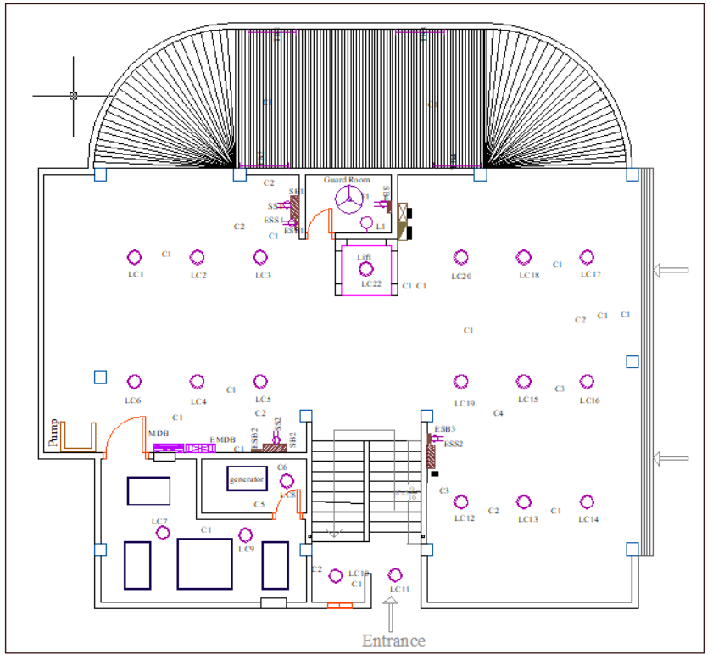
Fitting and Fixtures Layout – Ground Floor

Slide 13
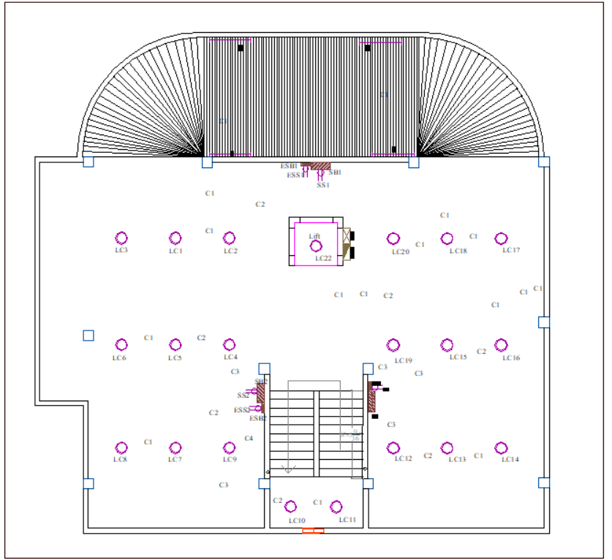
Fitting and Fixtures Layout – first and second Floor

Slide 14
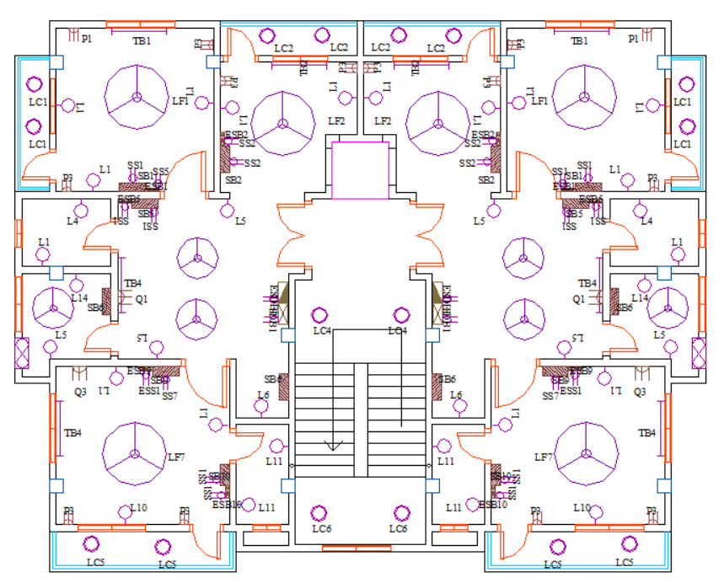
Fitting and Fixtures Layout – Typical Floor

Slide 15
Conduit Schedule
Legends for conduit:
Label | Wire size | Wire current rating | Conduit radius
C1 | 2*1.5 rm BYM | 5A | ¾”
C2 | 4*1.5 rm BYM | 5A | ¾”
C3 | 6*1.5 rm BYM | 5A | ¾”
C4 | 8*1.5 rm BYM | 5A | 1”
C5 | 10*1.5 rm BYM | 5A | 1”
C6 | 12*1.5 rm BYM | 5A | 1.25”
C7 | 14*1.5 rm BYM | 5A | 1.25”
C8 | 2*2.5 rm BYM + 2.5 rm BYA ECC | 10A | ¾”
C9 | 2*4 rm BYM + 4 rm BYA ECC | 15A | ¾”
C10 | 4*2.5 rm BYM + 2*2.5 rm BYA ECC | 10A | 1”
C11 | 6*2.5 rm BYM + 3*2.5 rm BYA ECC | 10A | 1.25”
C12 | 2*1.5 rm BYM + 1.5 rm BYA ECC | 5A | ¾”
C13 | 4*1.5 rm BYM + 2*1.5 rm BYA ECC | 5A | ¾”
C14 | 6*1.5 rm BYM + 3*1.5 rm BYA ECC | 5A | 1”
C12,9 | 2*16 rm BYM + 16 rm BYA ECC+ 2*4 rm BYM + 4 rm BYA ECC | 5A, 15A | 1.25”
C9,9 | 4*4 rm BYM + 2*4 rm BYA ECC | 30A | 6/4”

Slide 16
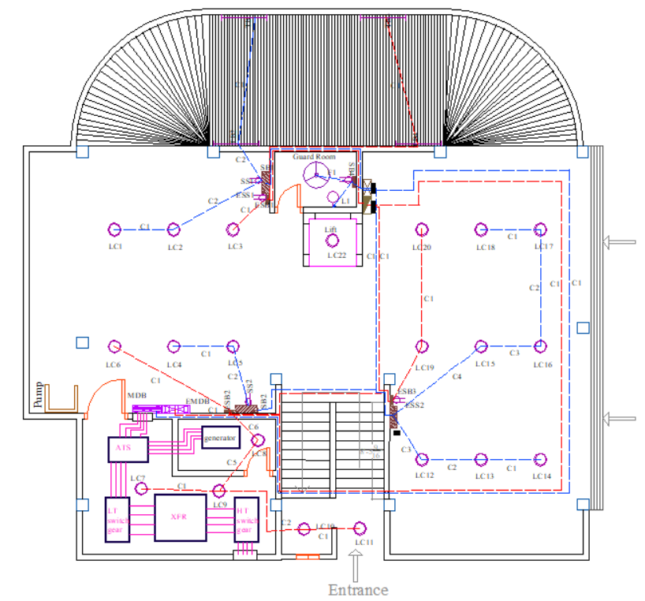
Conduit Layout – Ground Floor

Slide 17
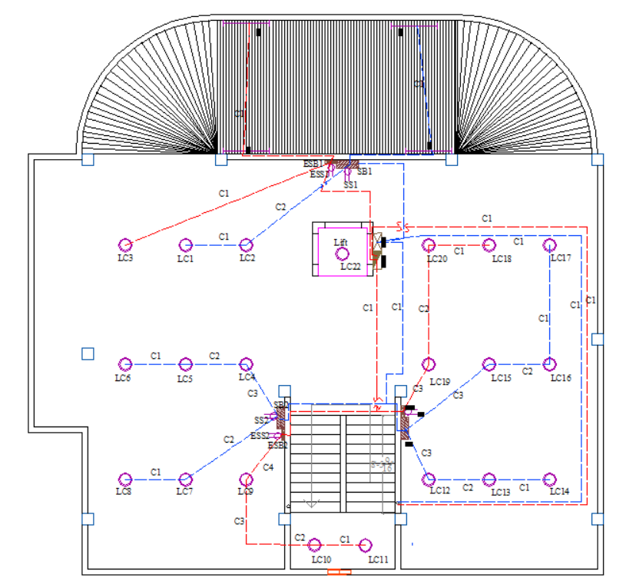
Conduit Layout – first and second Floor

Slide 18
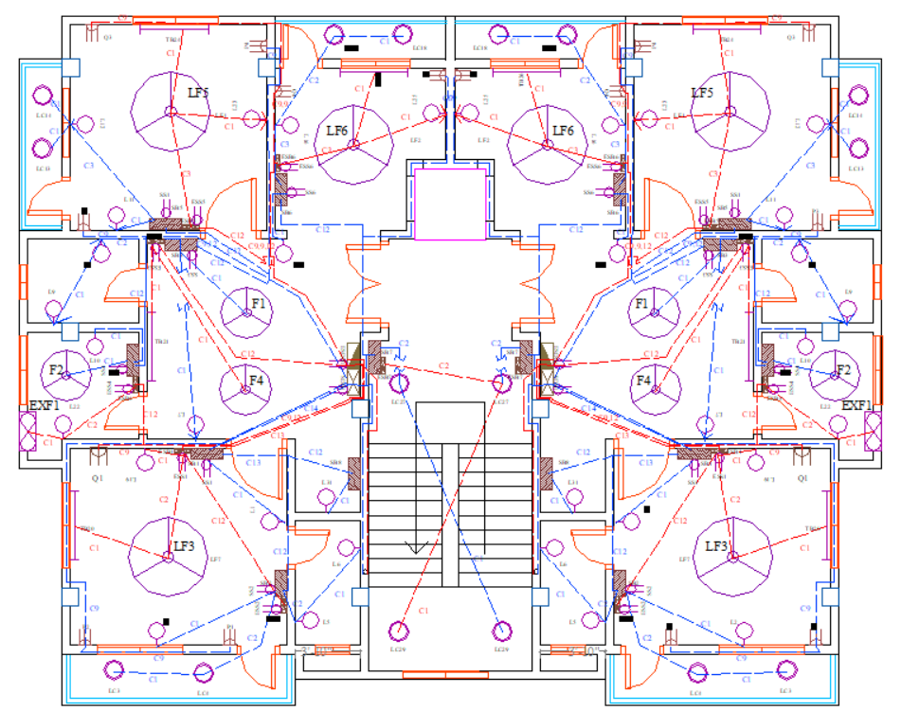
Conduit Layout – third and above Floor

Slide 19
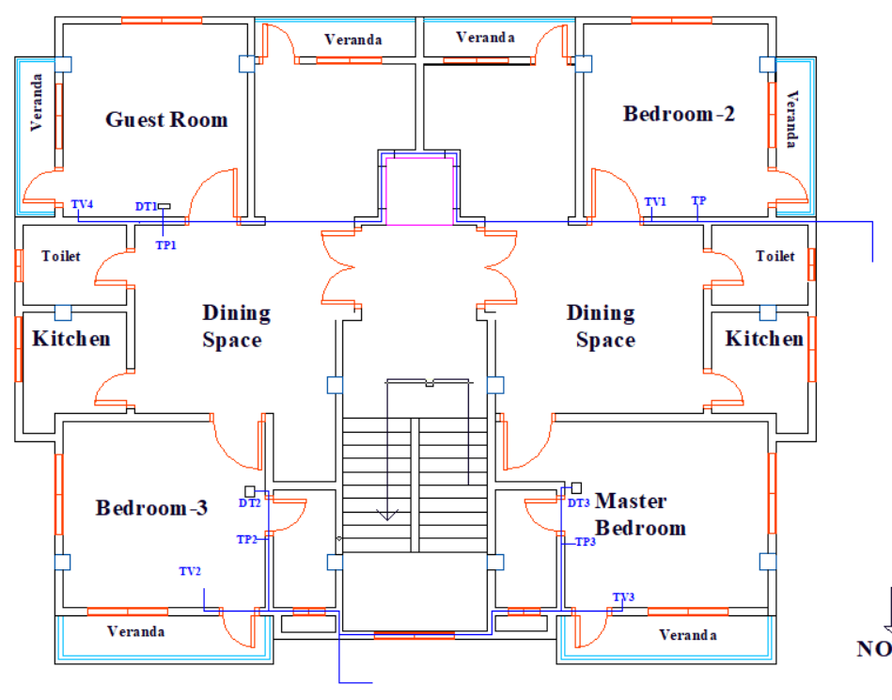
Conduit of TV, Telephone and Data Network

Slide 20
Calculation For Lightning Protection System
Building Length – 48’-8” Building width -35’-4”
Air conductor calculation: One conductor at each of the 4 corners.
Maximum distance between 2 air conductor is 25’.
So, along width we need 2 air conductors at the middle.
And along length 2 air conductor is needed.
The perimeter of the building is 2*(48.6+35.3)=167.8 feet
So down conductor required is 167.8/100=2
So, Down conductor required is 2
For safety purpose we have taken 3 down conductor.

Slide 21
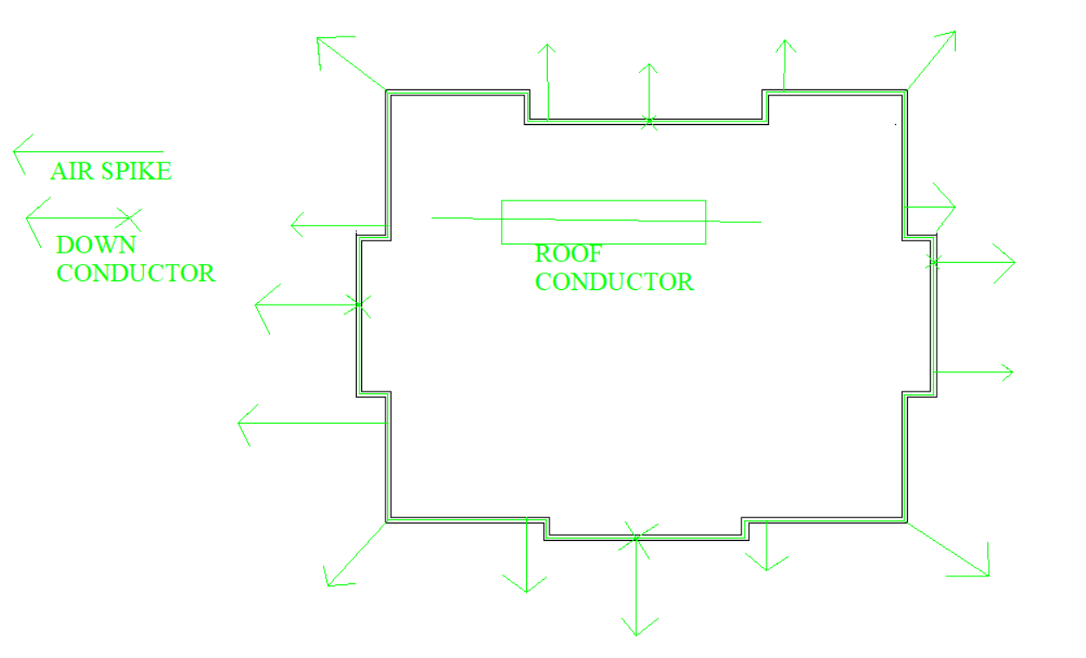
Lightning Protection System

Slide 22
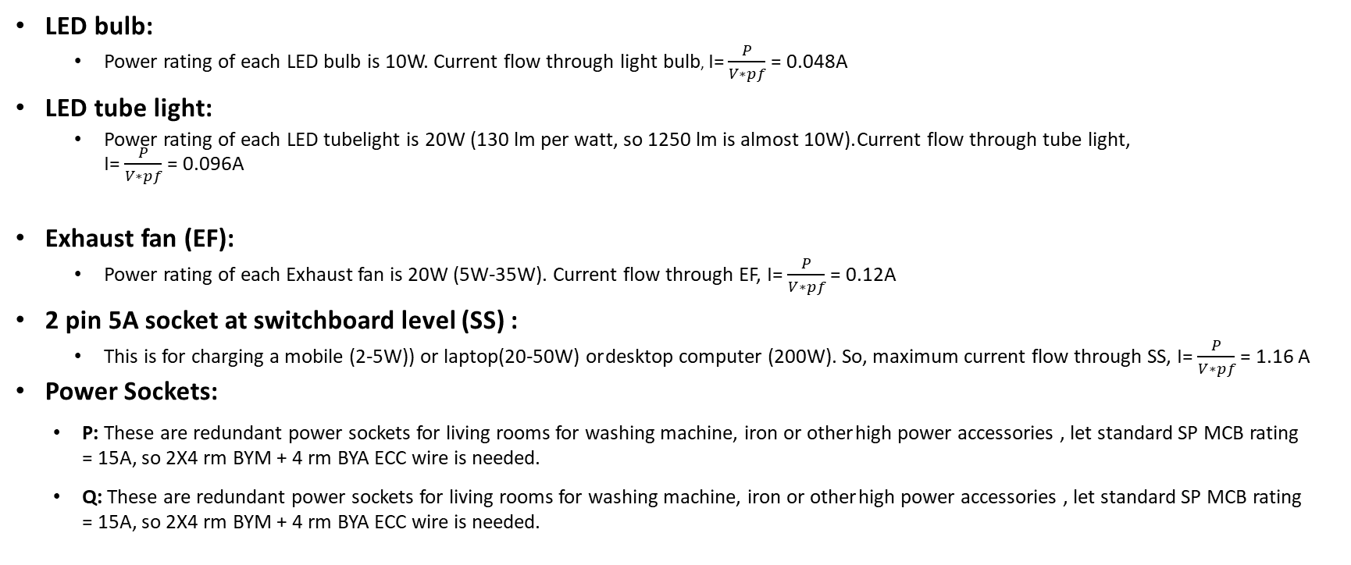
Current Calculation
LED bulb:
Power rating of each LED bulb is 10W. Current flow through light bulb, I= $\frac{P}{V∗pf}$ = 0.048A
LED tube light:
Power rating of each LED tubelight is 20W (130 lm per watt, so 1250 lm is almost 10W). Current flow through tube light, I= $\frac{P}{V∗pf}$ = 0.096A
Exhaust fan (EF):
Power rating of each Exhaust fan is 20W (5W-35W). Current flow through EF, I= $\frac{P}{V∗pf}$ = 0.12A
2 pin 5A socket at switchboard level (SS) :
This is for charging a mobile (2-5W)) or laptop(20-50W) or desktop computer (200W). So, maximum current flow through SS, I= $\frac{P}{V∗pf}$ = 1.16 A
Power Sockets:
P: These are redundant power sockets for living rooms for washing machine, iron or other high power accessories , let standard SP MCB rating = 15A, so 2X4 rm BYM + 4 rm BYA ECC wire is needed.
Q: These are redundant power sockets for living rooms for washing machine, iron or other high power accessories , let standard SP MCB rating = 15A, so 2X4 rm BYM + 4 rm BYA ECC wire is needed.

Slide 23
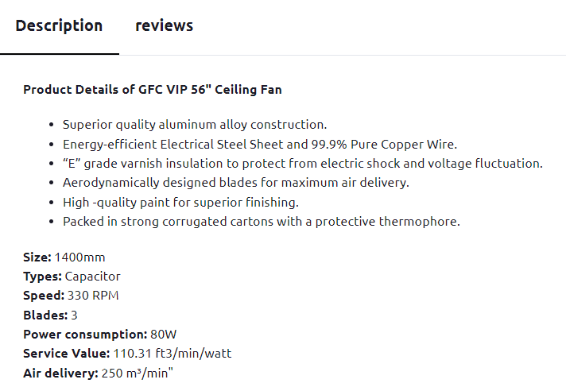
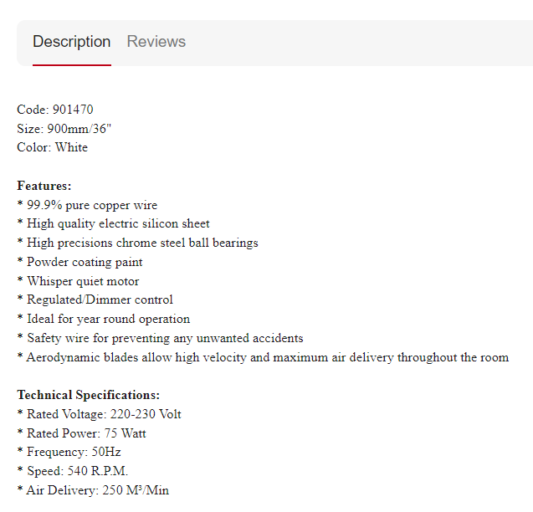
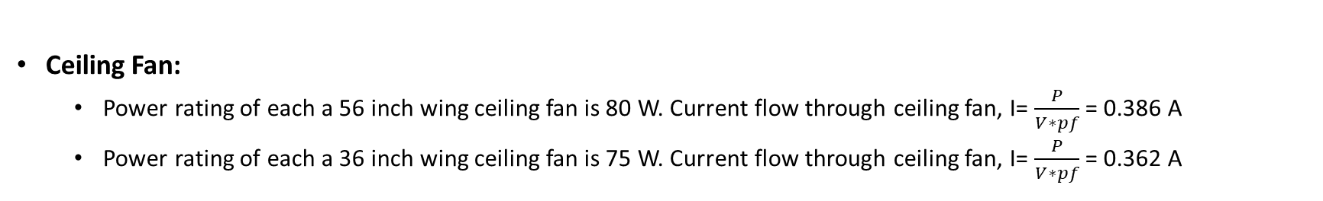
Current Calculation
Ceiling Fan:
Power rating of each a 56 inch wing ceiling fan is 80 W. Current flow through ceiling fan, I= $\frac{P}{V∗pf}$ = 0.386 A
Power rating of each a 36 inch wing ceiling fan is 75 W. Current flow through ceiling fan, I= $\frac{P}{V∗pf}$ = 0.362 A

Slide 24
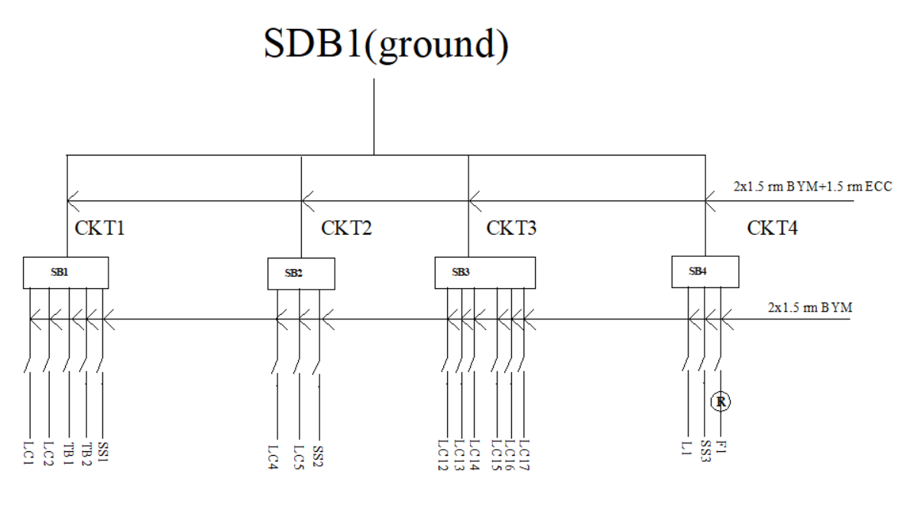
Switch Board Connection Diagram – Ground Floor

Slide 25
Circuit Current calculation– Ground Floor
CKT1:
Component connecting to SB1 are LC1,LC2,TB1,TB2 and SS1.
Total current for circuit1=2*0.048+2*0.096+1.16=1.448A < 5A
So 2x1.5 rm BYM +1.5 rm BYA ECC cable are required.
CKT2:
Component connecting to SB2 are LC4,LC5 and SS2.
Total current for circuit2=0.048+0.048+1.16=1.256A < 5A
So 2x1.5 rm BYM +1.5 rm BYA ECC cable are required.
CKT3:
Component connecting to SB3 are LC12,LC13,LC14,LC15,LC16,LC17.
Total current for circuit3=6*0.048=0.288A < 5A
So 2x1.5 rm BYM +1.5 rm BYA ECC cable are required.
CKT4:
Component connecting to SB4 are L1,F1, SS3.
Total current for circuit4=0.048+0.362+1.16=1.57A < 5A
So 2x1.5 rm BYM +1.5 rm BYA ECC cable are required.

Slide 26
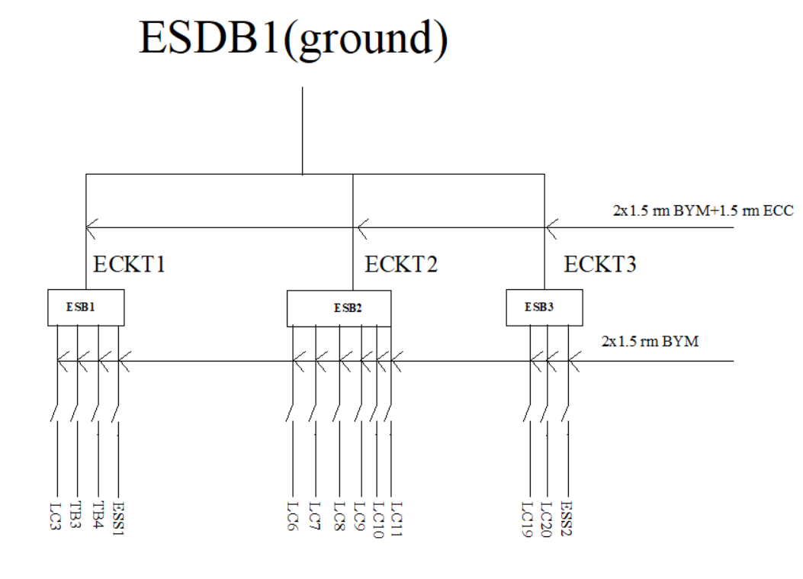
Emergency Switch Board Connection Diagram – Ground Floor

Slide 27
Emergency Circuit Current calculation– Ground Floor
ECKT1:
Component connecting to ESB1 are LC3,TB3,TB4 and ESS1.
Total current for circuit1=0.048+2*0.096+1.16=1.4A < 5A
So 2x1.5 rm BYM +1.5 rm BYA ECC cable are required.
ECKT2:
Component connecting to ESB2 are LC6,LC7,LC8,LC9,LC10,LC11.
Total current for circuit2=6*0.048=0.288A < 5A
So 2x1.5 rm BYM +1.5 rm BYA ECC cable are required.
ECKT3:
Component connecting to ESB3 are LC19,LC20,ESS2
Total current for circuit3=2*0.048+1.16=1.256A < 5A
So 2x1.5 rm BYM +1.5 rm BYA ECC cable are required.

Slide 28
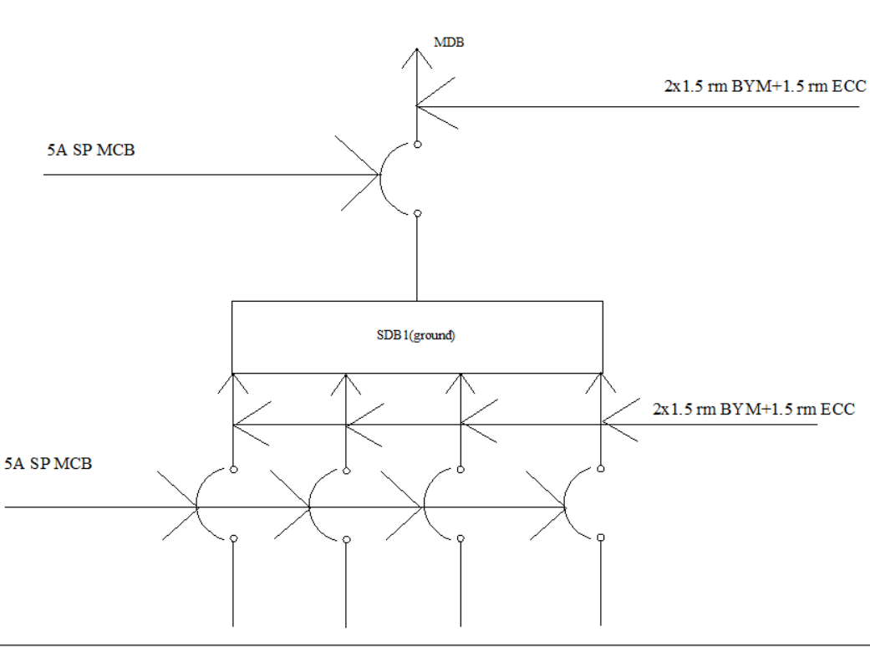
Sub Distribution Board(SDB) Diagram – Ground Floor

Slide 29
SDB Circuit Current calculation– Ground Floor
CKT1 =1.448A
CKT2 =1.256A
CKT3 =0.288A
CKT4 =1.57A
Total Current = 4.562A < 5A
So 2x1.5 rm BYM +1.5 rm BYA ECC cable are required

Slide 30
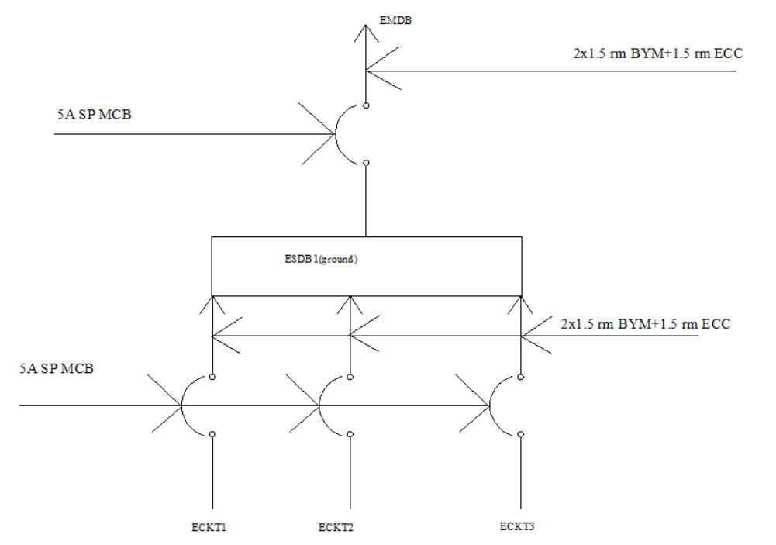
Emergency Sub Distribution Board(ESDB) Diagram – Ground Floor

Slide 31
ESDB Circuit Current calculation– Ground Floor
ECKT1 =1.44A
ECKT2 =0.288A
ECKT3 =1.256A
Total Current = 2.984A < 5A
So 2x1.5 rm BYM +1.5 rm BYA ECC cable are required

Slide 32
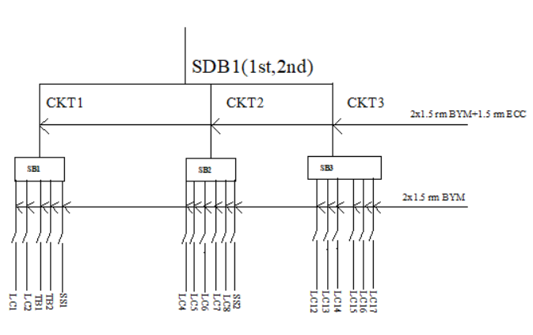
Switch Board Connection Diagram – 1st and 2nd Floor

Slide 33
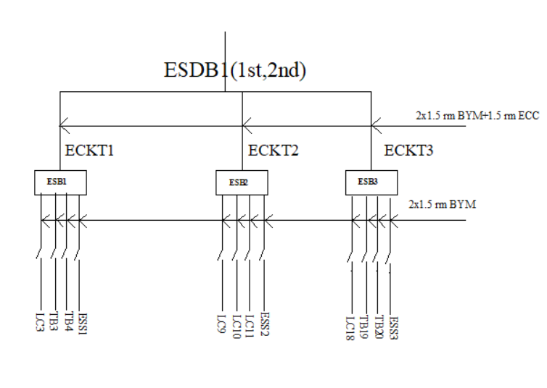
Emergency Switch Board Connection Diagram – 1st and 2nd Floor

Slide 34
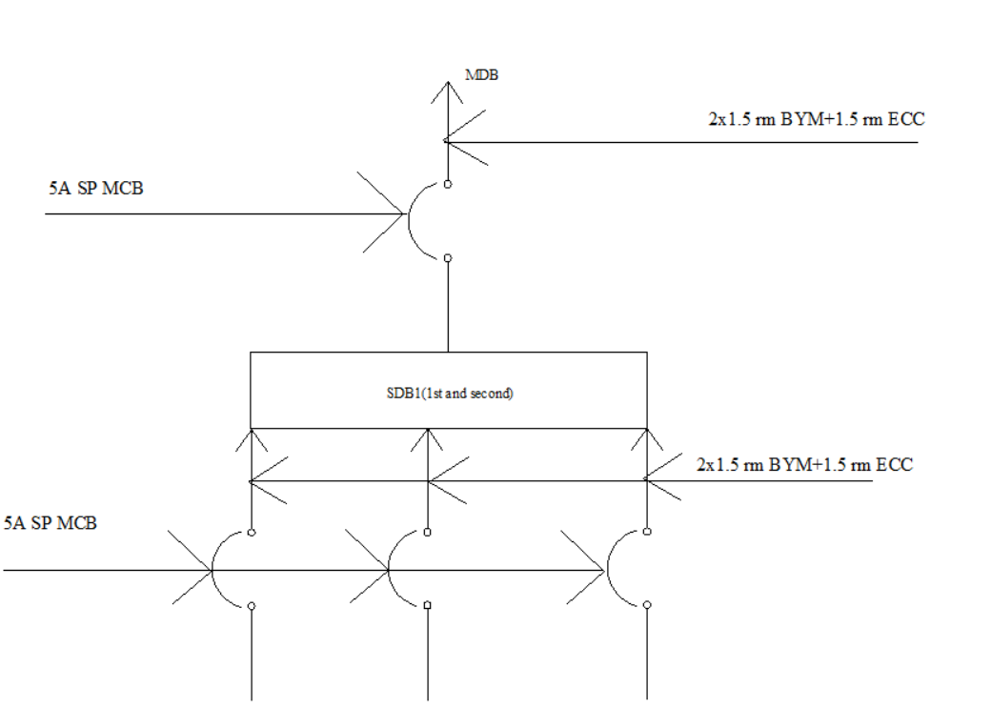
Sub Distribution Board(SDB) Diagram – 1st and 2nd Floor

Slide 35
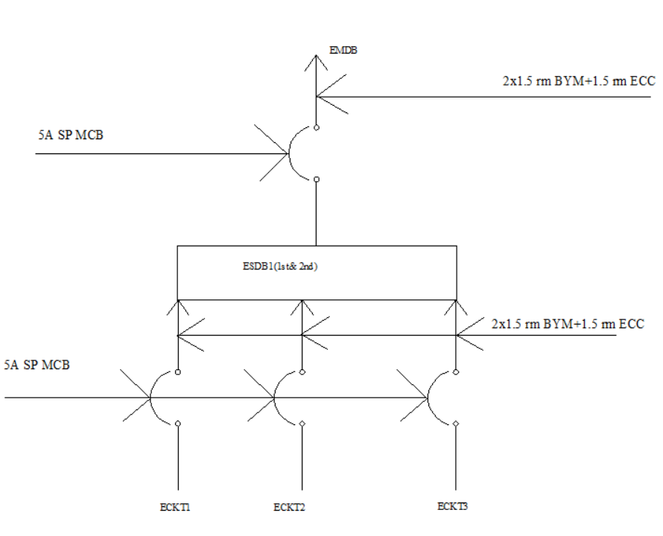
Emergency Sub Distribution Board(ESDB) Diagram – 1st and 2nd Floor

Slide 36
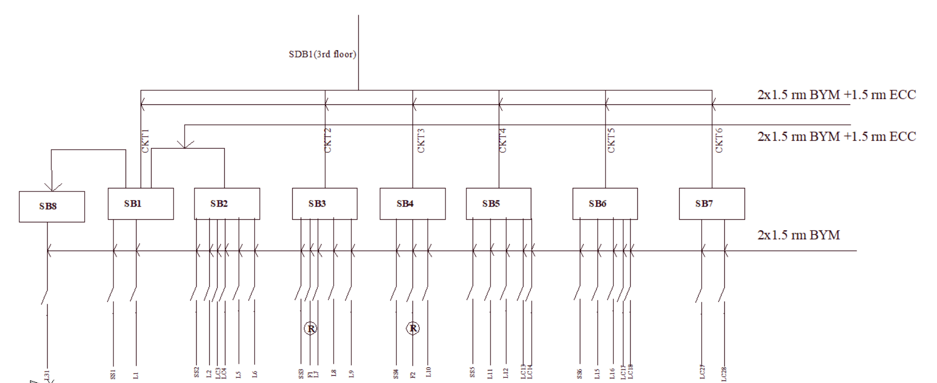
Switch Board Connection Diagram – Third Floor SDB1

Slide 37
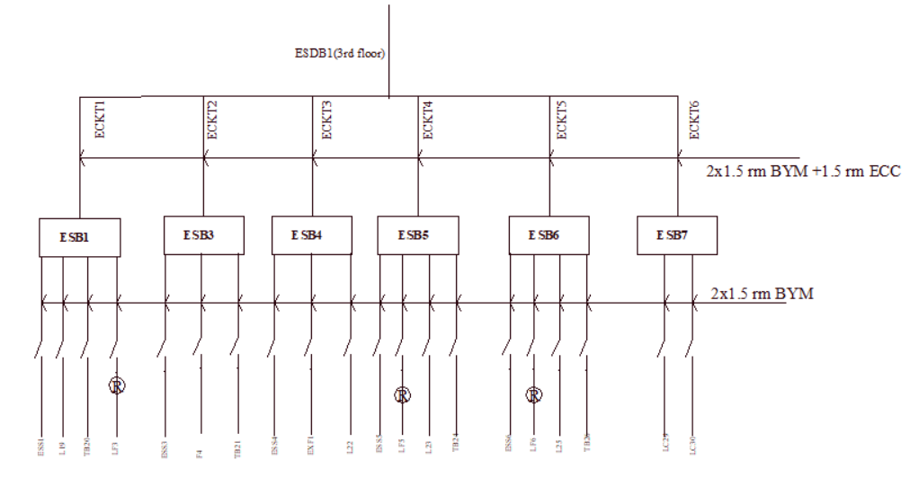
Switch Board Connection Diagram – Third Floor ESDB1

Slide 38
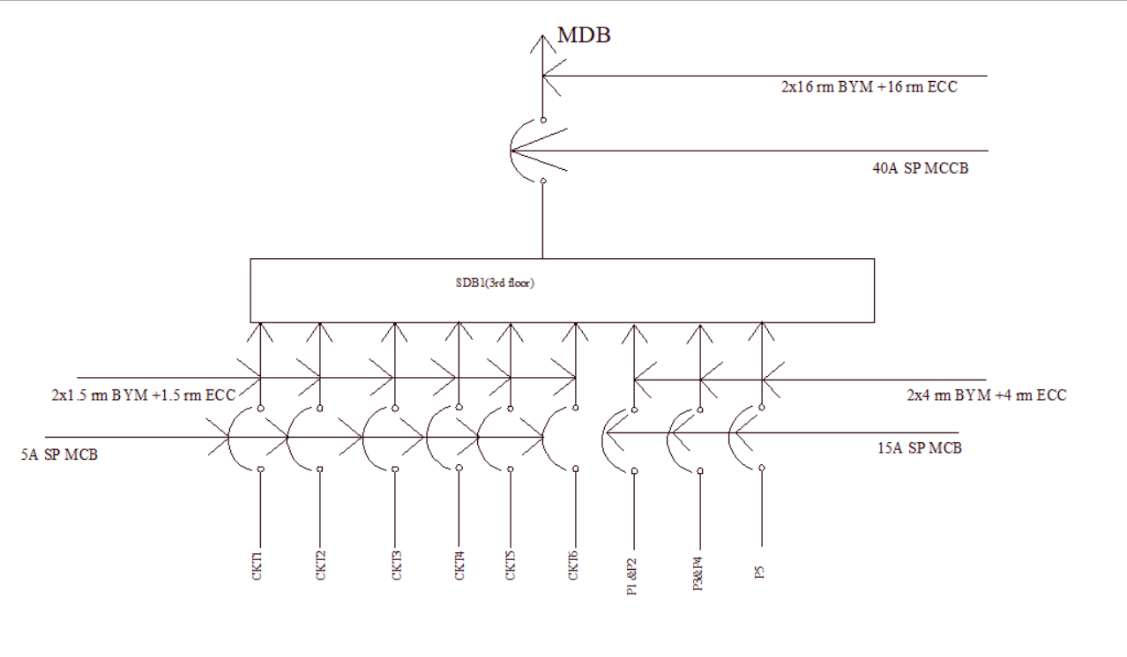
Sub Distribution Board(SDB) Diagram – third Floor

Slide 39
SDB Current Calculation– Third Floor SDB1
CKT1 =2.656A
CKT2 =1.663A
CKT3 =1.57A
CKT4 =1.352A
CKT5 =1.352A
CKT6 =0.096A
P = 15A * 3
Total Current = 8.689 + P x0.5 = 31.189A
So 2x16 rm BYM +16 rm BYA ECC cable are required

Slide 40
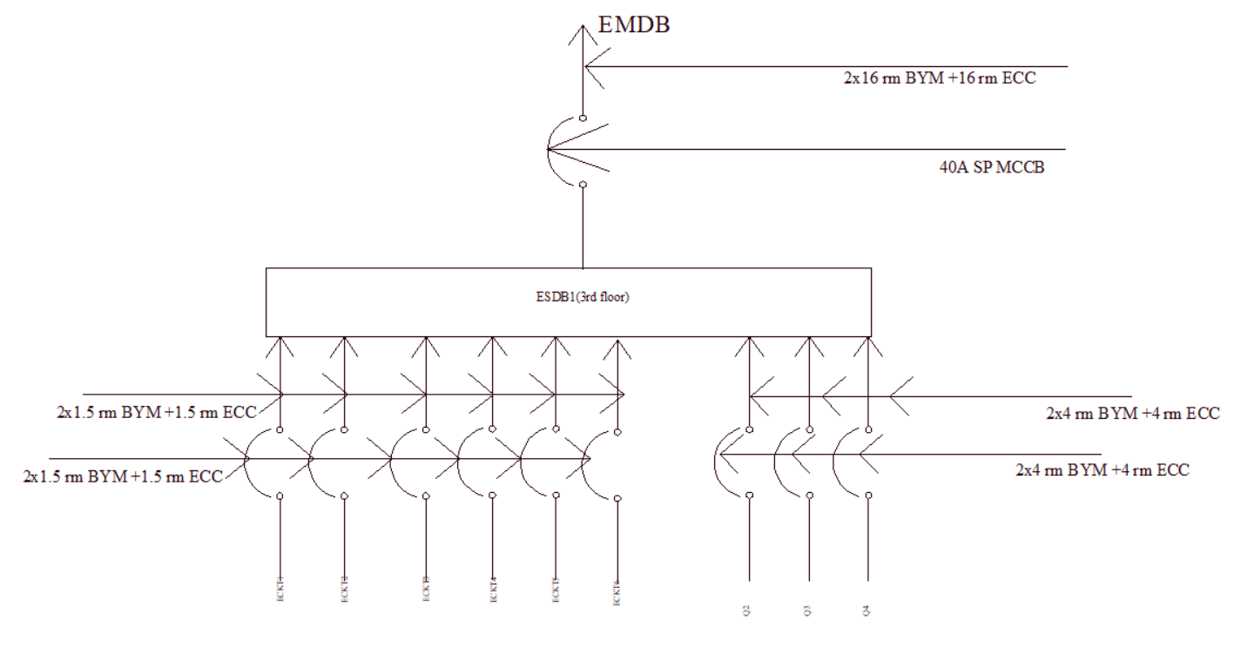
Emergency Sub Distribution Board(ESDB) Diagram – third Floor

Slide 41
ESDB Current Calculation– Third Floor ESDB1
ECKT1 =1.6904A
ECKT2 =1.6183A
ECKT3 =1.328A
ECKT4 =1.6904A
ECKT5 =1.6904A
ECKT6 =0.096A
Q = 15A * 3
Total Current = 8.096 + Q x0.5 = 30.596A
So 2x16 rm BYM +16 rm BYA ECC cable are required

Slide 42
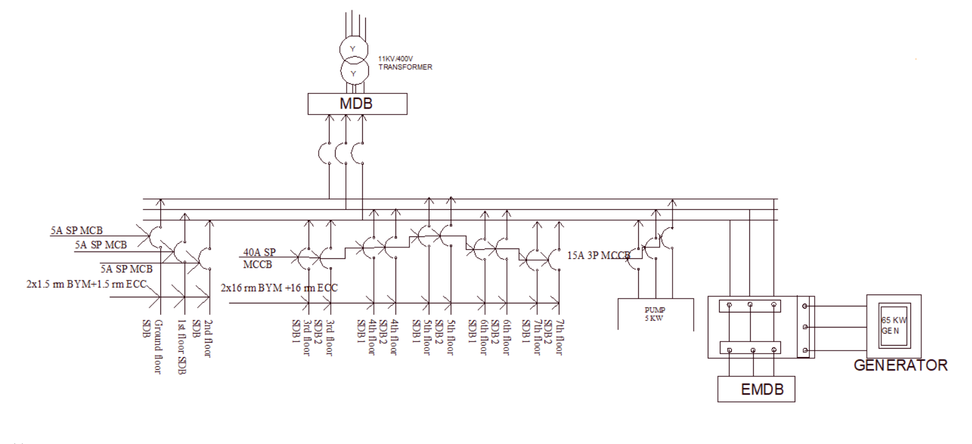
Main Distribution Board diagram

Slide 43
POWER Calculation for MDB
Floor0:
P=VI*PF=230*4.56*0.9=943.94 Watt
Floor1:
P=VI*PF=230*3.136*0.9=649.152Watt
Floor2:
P=VI*PF=230*3.136*0.9=649.152Watt
Floor3:
P=VI*PF=230*31.189*0.9=6.5KWatt
Floor4:
P=VI*PF=230*31.189*0.9=6.5KWatt
Floor5:
P=VI*PF=230*31.189*0.9=6.5KWatt
Floor6:
P=VI*PF=230*31.189*0.9=6.5KWatt
Floor7:
P=VI*PF=230*31.189*0.9=6.5KWatt
PUMP:
p = 5kw
Total power=39.7KW

Slide 44
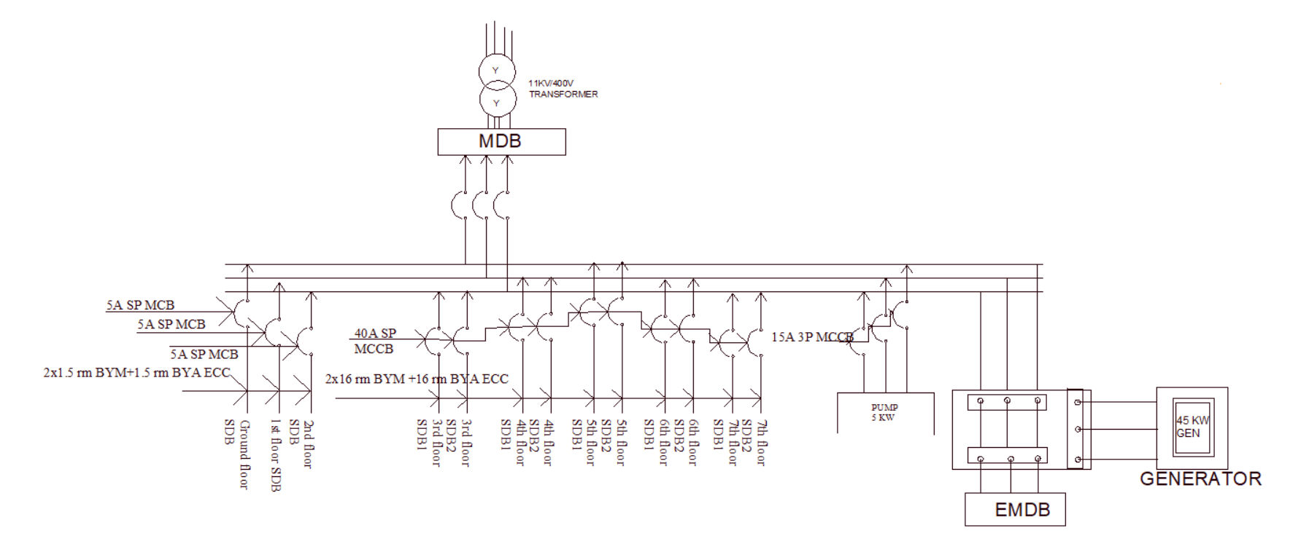
Emergency Main Distribution Board diagram

Slide 45
POWER Calculation for EMDB
Floor0:
P=VI*PF=230*3.024*0.9=625 Watt
Floor1:
P=VI*PF=230*4.104*0.9=849.5Watt
Floor2:
P=VI*PF=230*4.104*0.9=849.5Watt
Floor3:
P=VI*PF=230*30.596*0.9=6. 3KWatt
Floor4:
P=VI*PF=230*30.596*0.9=6. 3KWatt
Floor5:
P=VI*PF=230*30.596*0.9=6. 3KWatt
Floor6:
P=VI*PF=230*30.596*0.9=6. 3KWatt
Floor7:
P=VI*PF=230*30.596*0.9=6. 3KWatt
Lift:
P = 8Kw
Total power=41.8KW

Slide 46
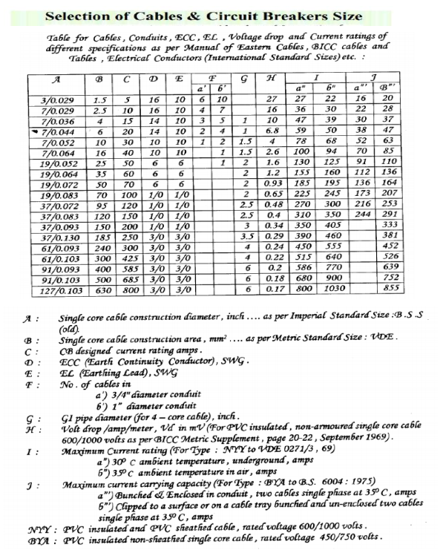
Reference

Slide 47
Thank You

